Slide 1

Module 7 – SMA-X Problem Mgmt
Jan 2018
Notes:
[STANDARD SLIDE: L300 (animated)]
You can change out the photo with any image from Getty Images in DropBox.
If the main title is shorter, you can make the font larger.
You may have to move the title text around depending on the photo. Make sure the text is readable against the background photo.
You can change the background color for the rectangle in the bottom-right corner to look better against the background. Choose a Micro Focus color at 25% transparency.
=========================
Note to Narrator or Reader: [PRESS] indicates press the Page Down key to show the animation
=========================
Hello and Welcome to the [COURSE_NAME] Technical Overview Training, Level 300.
In this course you’ll gain a high-level understanding of the essentials of [PRODUCT_NAME].
[PRESS] If you want to download this presentation and save it on your own system, click the Tools & Help icon in the bottom-right corner of your window and select Download.
Or, if you want to access the PPT slides and speaker notes for future reference, go to the Attachments tab in your window click to download the presentation.

Slide 2
Objectives
After completing this module, you should be able to:
Describe key features of Problem Management
Create Problems from Incidents
Mark a problem as a Known Error
Understanding How to Use Problem Hot Topic Analytics

Slide 3
Overview

Slide 4
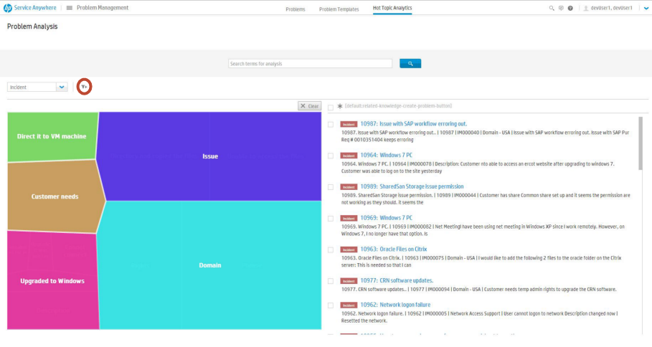
Problem Management Overview Identify, record, track, and resolve problems.
Known Errors
Hot Topic Analytics in Problem Management use
the advanced search and analytics capabilities in
SMA-X to enable you to view and
analyze incidents, and to create problem records
based on those incidents.
Problem templates
A Service Anywhere template is a group of pre-populated fields that you can use as a quick start to create a new record or apply to an existing record.
You can create a template with either from an existing incident or create a new one from the menu option

Slide 5
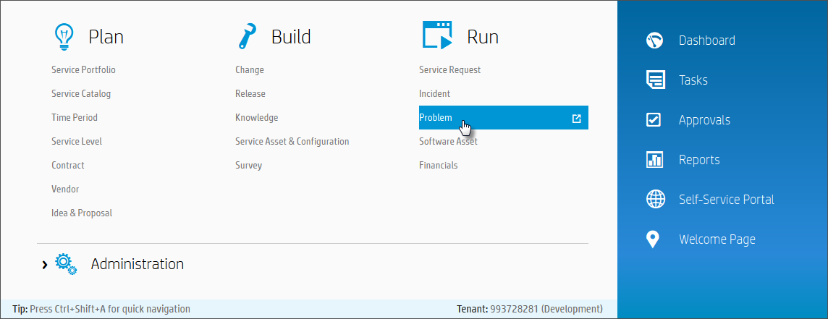
IT Agent Accessing Problem Management
Mega Menu > Run > Problem

Slide 6
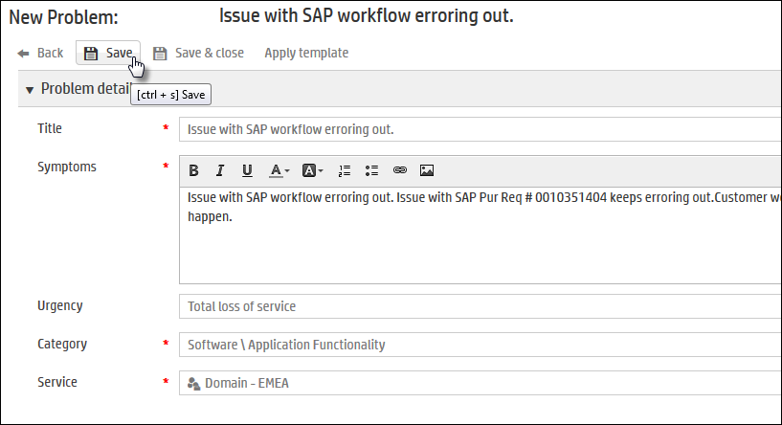
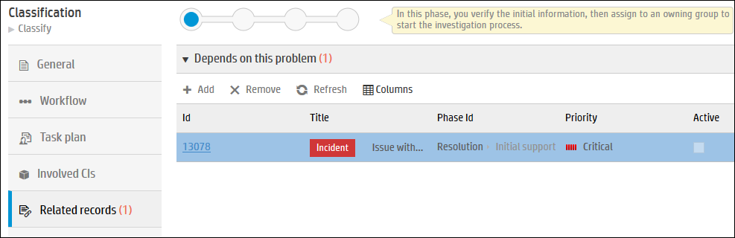
How to Open a New Problem
A new problem can be opened from Problem List, from within an incident or other record types or from Hot Topic Analytics trend map
The new problem will be displayed. Click Save
The incident and problem will be related

Slide 7
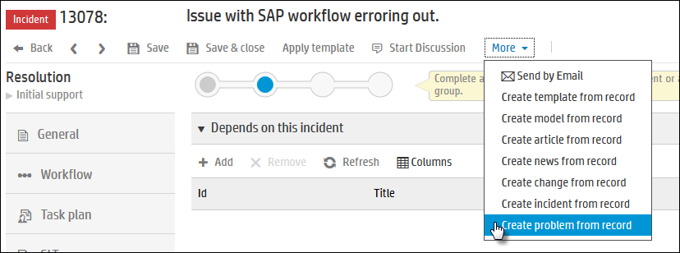
How to Open a New Problem – Recap
A new problem can be opened from Problem List, from within an incident or other record types and from Hot Topic Analytics trend map
From within an Incident, from the More menu, click Create problem from record.

Slide 8
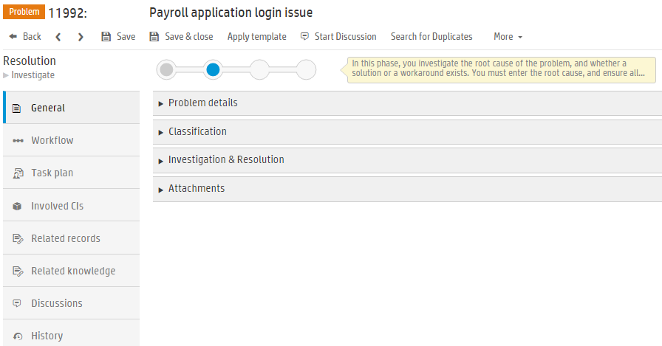
Problem Management
Record content

Slide 9
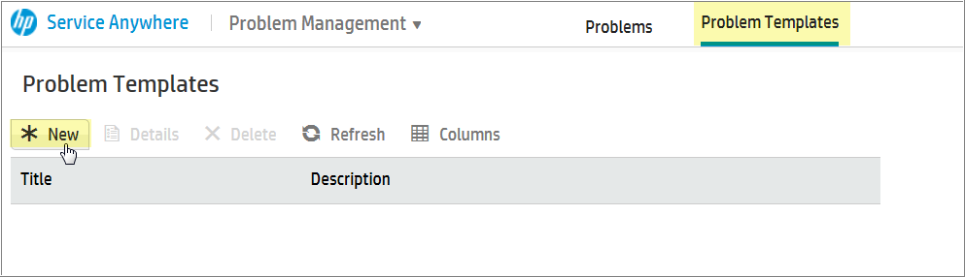
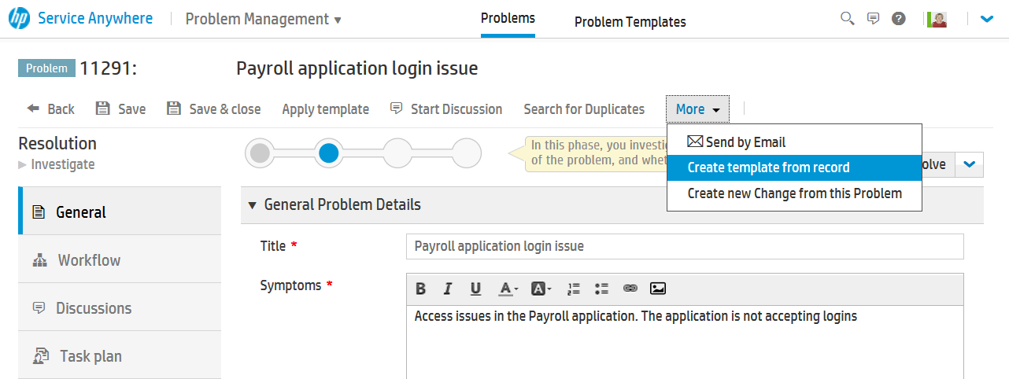
Problem Templates
Save a template from an existing record
Create a new template

Slide 10
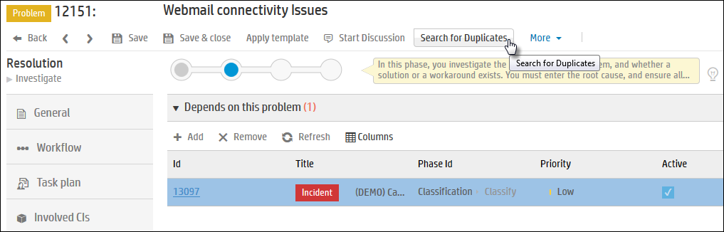
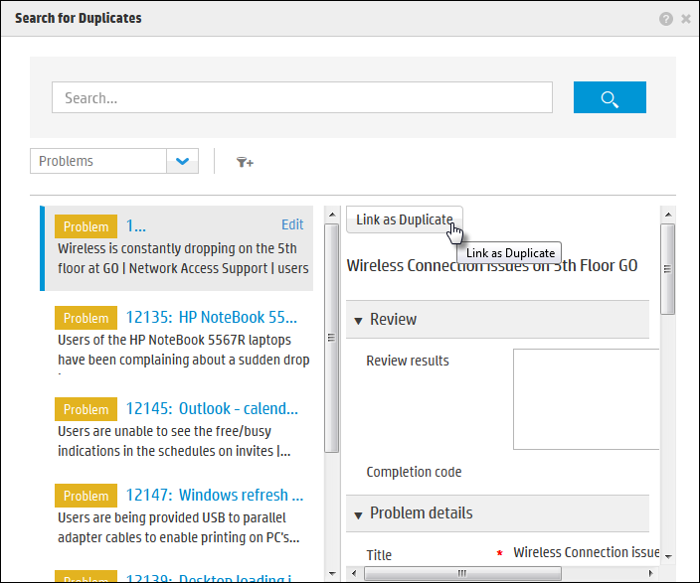
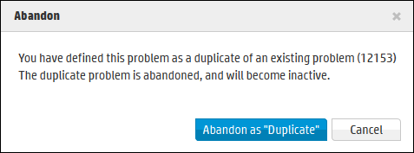
Searching for Duplicate Problems
1. From problem, click Search for Duplicates
Ensures efficient use of resources
Link as duplicate
Abandon as duplicate
2. In Duplicate List, select a duplicate and click Link as Duplicate
3. Duplicate problem will be abandoned

Slide 11
Problem Workflow

Slide 12
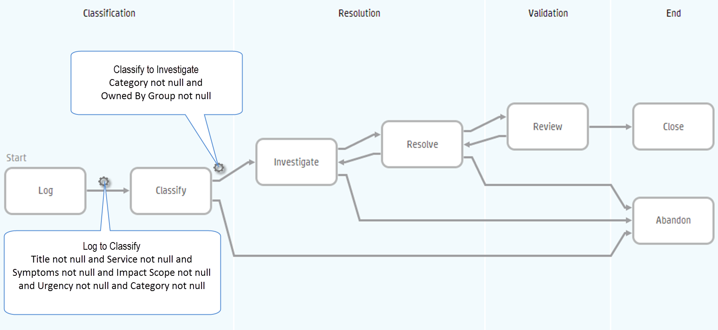
Problem Workflow – Automatic Transitions

Slide 13
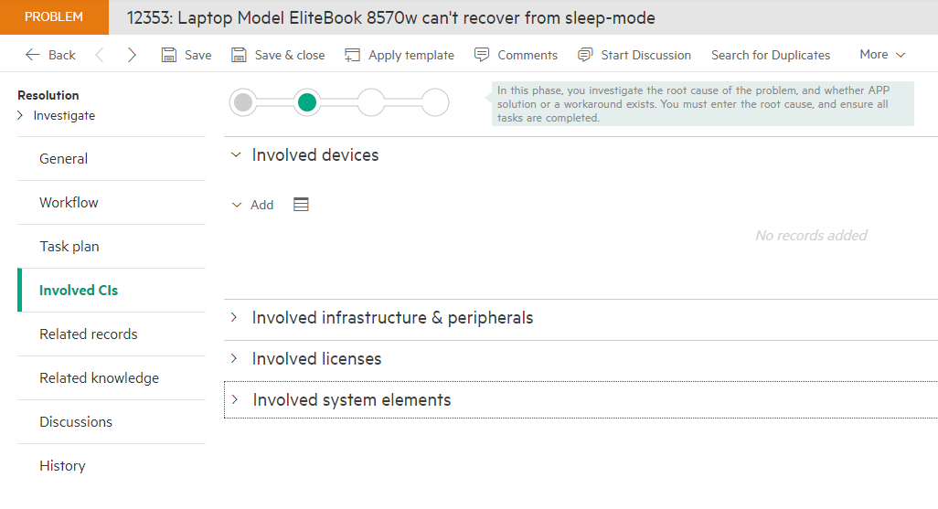
Problem and SACM model
General tab
Actual service
Service Component
Involved CIs tab
Devices
Involved Infrastructure & peripherals
Involved Licenses
System elements

Slide 14
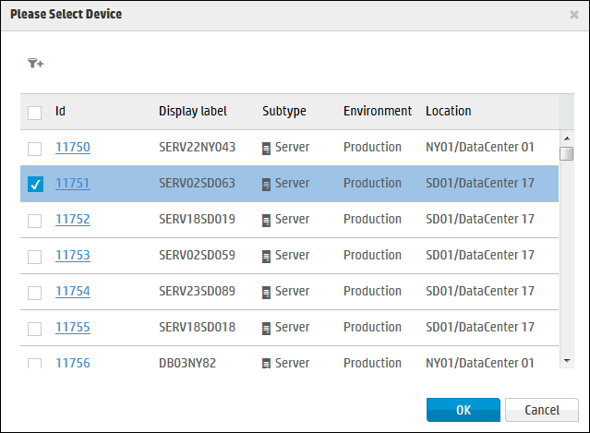
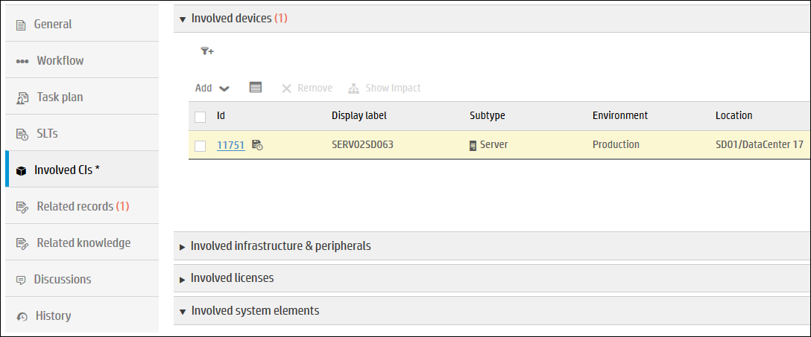
Involved CIs

Slide 15
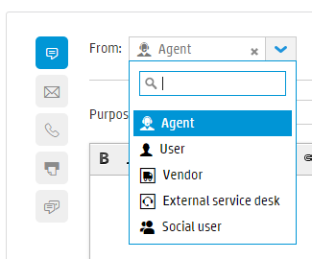
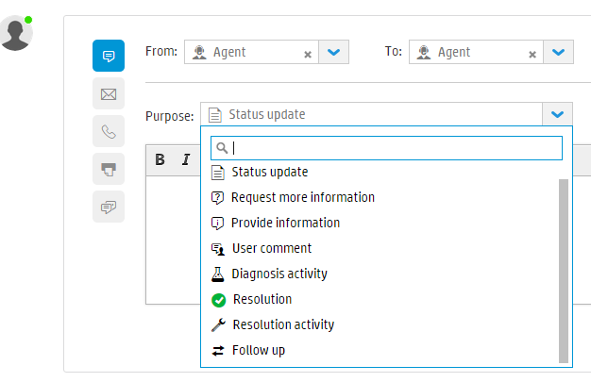
Comments / Discussions
Comments Types
Agents can flag a discussion comment with a type
E.g. : Internal comment, communication with Vendor, Customer Update, etc…
Comment Based Events and BR Processing
Enables configurable use cases
Flag records as updated
Propagate comments from incident to Request
Suspend request depending on Comment’s purpose

Slide 16
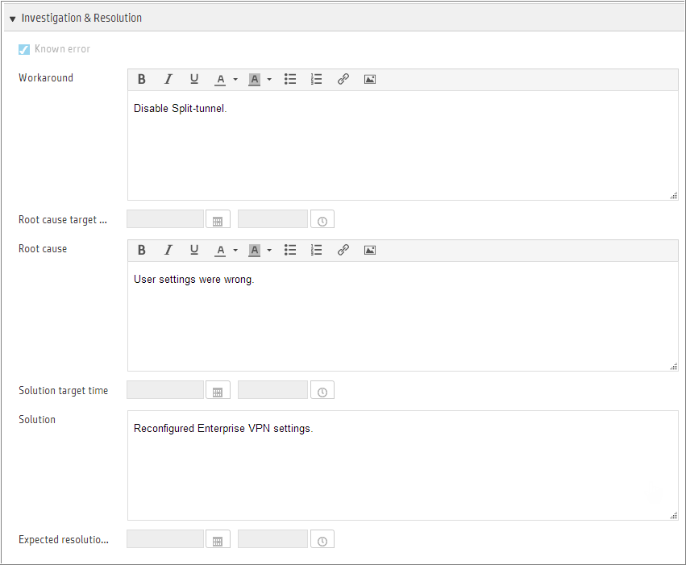
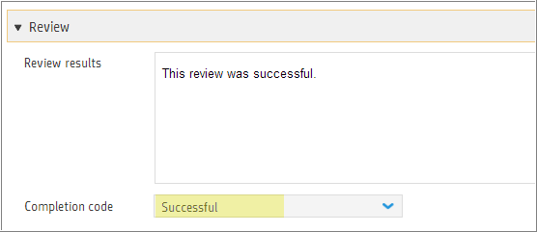
Investigation & Resolve
Known Error
Work around
Root Cause
Solution
Closing Review results and Completion Code

Slide 17
Hot Topic Analytics

Slide 18
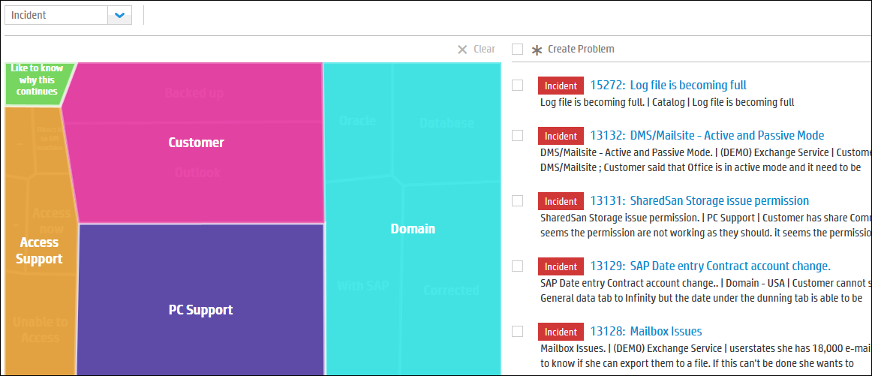
Hot Topic Analytics
Mega Menu > Run > Problem > Hot Topic Analytics
Hot Topic Analytics provides trend analysis of incidents which share common issues.
Notes:
Hot Topic Analytics for Incidents and Problems
Hot Topic Analytics in Problem Management use the advanced search and analytics capabilities in Service Anywhere to enable you to view and analyze incidents, and to create problem records based on those incidents.
The hot topics map provides trend analysis so you can visually identify incidents that share common issues. The map in Problem Management includes all incidents in the system. It does not include any other record type. In the filter above the map, you cannot select any other record types as it defaults to Incidents, but you can select a service type as a secondary filter using the Add filter icon

Slide 19
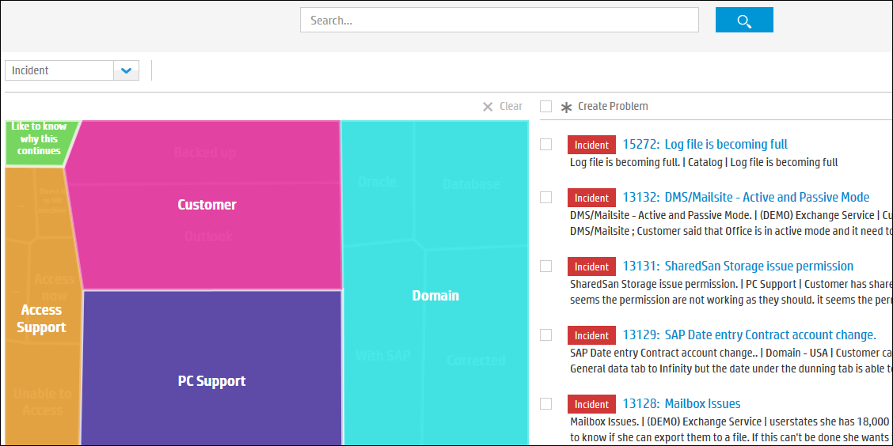
Hot Topic Analytics
Search in hot topic map for key words
Search Incidents for similar issues
Click on a topic in the map to drill down into that topic.
Powered by Big Data analytics of unstructured data
Global Search
Multi-select Incidents to create a problem
Click on topic to drill down further
Notes:
You can drill down into the map and view the specific incidents related to an issue. The topics displayed in the image above are from the sample data and are displayed for you only if the sample data is deployed in your environment.
In the list of incidents on the right, you can select multiple incidents to create a problem based on those similar incidents. The fields in the problem created are populated by the information only from the first incident selected. All other incidents become the new problem's related links.
When navigating through the map, click the Clear button to go back to your previous view of the map. If you used the search field at the top of the page to view incidents, that search remains active until the search field is cleared. This is regardless of clicking the Clear button which applies only to navigating within the map.

Slide 20
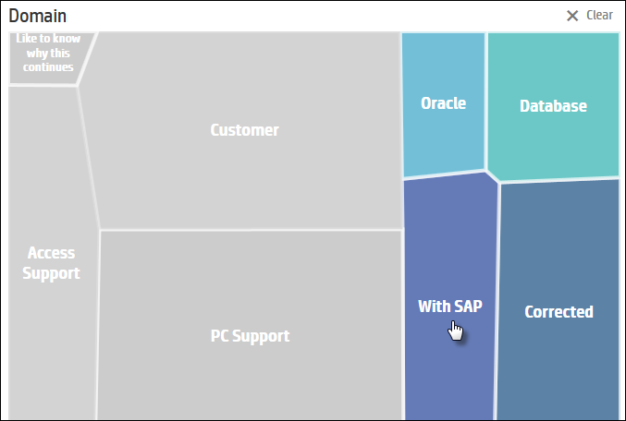
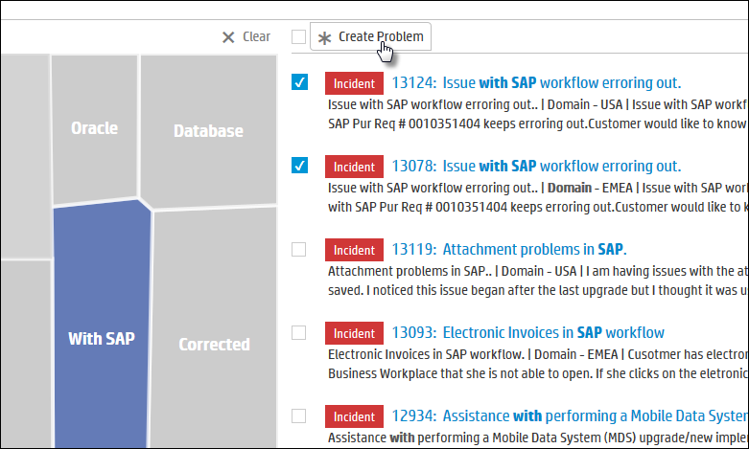
Hot Topic Analytics
Drill-down into topics, multi-select Incidents to Create a Problem
Create problem from incidents
Multi-select incidents to create a problem
Notes:
You can drill down into the map and view the specific incidents related to an issue. The topics displayed in the image above are from the sample data and are displayed for you only if the sample data is deployed in your environment.
In the list of incidents on the right, you can select multiple incidents to create a problem based on those similar incidents. The fields in the problem created are populated by the information only from the first incident selected. All other incidents become the new problem's related links.
When navigating through the map, click the Clear button to go back to your previous view of the map. If you used the search field at the top of the page to view incidents, that search remains active until the search field is cleared. This is regardless of clicking the Clear button which applies only to navigating within the map.

Slide 21


Exercise
In this On-Screen Exercise…
Create a new Incident. Mark the Incident as a Problem Candidate. Save. Go to your Dashboard.
Search for your problem candidate using Global Search.
Go to the Incident Mgmt module. Search for your problem candidate from the Incident List using a filter for Problem Candidates.
Open a related Problem. Mark it as a Known Error. Process it to closure
Use Analytics to create a Problem
Time Allocated – 30 minutes

